Slide 1
Vectors
OCR Stage 10

Slide 2
A VECTOR?
Describes the motion of an object
A Vector comprises
  Direction
  Magnitude
We will consider
  Column Vectors
  General Vectors
  Vector Geometry
Size

Slide 3
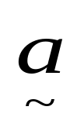
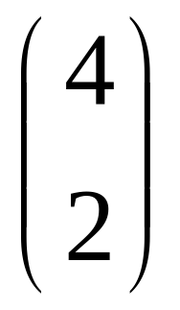
Column Vectors
NOTE!
Label is in BOLD.
When handwritten,
draw a wavy line
under the label
i.e.
Vector a
a
2 up
4 RIGHT
COLUMN Vector

Slide 4
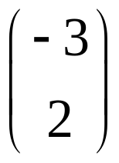
Column Vectors
Vector b
2 up
b
3 LEFT
COLUMN Vector?

Slide 5
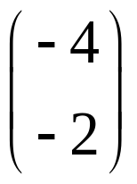
Column Vectors
Vector u
n
2 down
4 LEFT
COLUMN Vector?

Slide 6
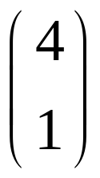
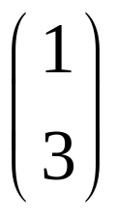
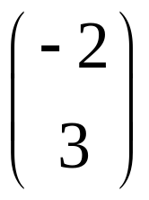
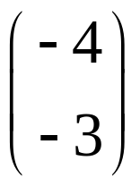
Describe these vectors
c
b
a
d

Slide 7

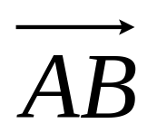
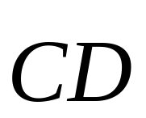

Alternative labelling
B
F
D
E
G
A
C
H

Slide 8
General Vectors
A Vector has BOTH a Length & a Direction
All 4 Vectors here are EQUAL in Length and
Travel in SAME Direction.
All called k
k
k
k
k
k can be in any position

Slide 9
General Vectors
B
Line CD is Parallel to AB
CD is TWICE length of AB
k
A
D
2k
Line EF is Parallel to AB
E
C
EF is equal in length to AB
-k
EF is opposite direction to AB
F

Slide 10
Write these Vectors in terms of k
k
B
D
2k
F
G
1½k
½k
E
A
C
-2k
H

Slide 11
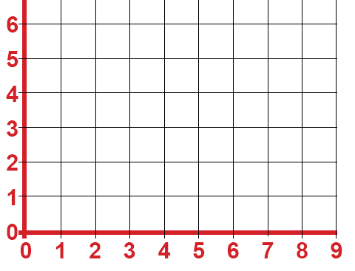
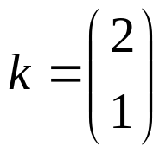



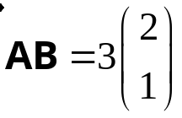
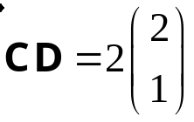
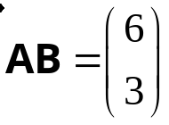
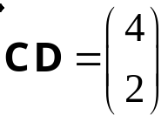
Combining Column Vectors
B
k
D
A
C

Slide 12
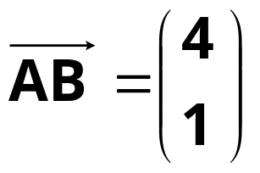
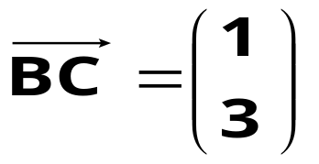
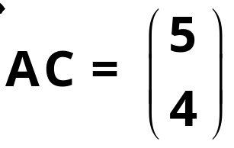
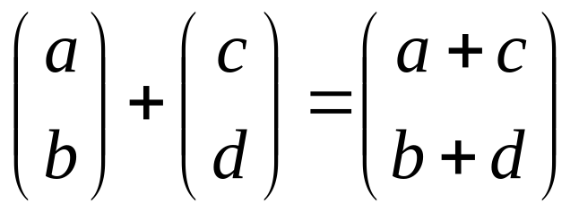
Simple combinations
C
B
A

Slide 13

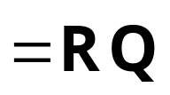

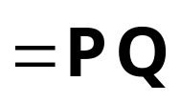
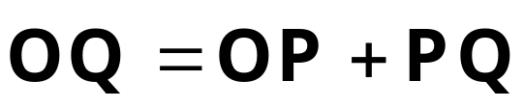

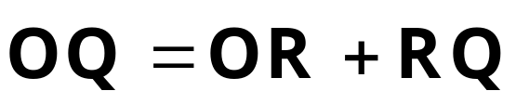


Vector Geometry
Consider this parallelogram
Q
P
a
R
Opposite sides are Parallel
b
O
OQ is known as the resultant of a and b

Slide 14
Resultant of Two Vectors
Is the same, no matter which route is followed
Use this to find vectors in geometrical figures

Slide 15
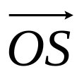
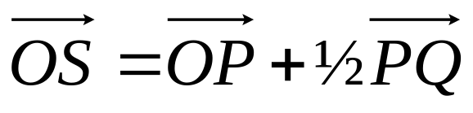
Example
S is the Midpoint of PQ.
Work out the vector
.
Q
S
P
a
R
= a + ½b
b
O

Slide 16

Alternatively
S is the Midpoint of PQ.
Work out the vector
.
Q
S
P
a
R
= b
+ a
- ½b
b
O
= ½b + a
= a + ½b

Slide 17
Example
C
AC= p, AB = q
p
M
M is the Midpoint of BC
A
q
B
Find BC
BC
=
BA
+
AC
= -q + p
= p - q

Slide 18
Example
C
AC= p, AB = q
p
M
M is the Midpoint of BC
A
q
B
Find BM
BM
=
½BC
= ½(p – q)

Slide 19
Example
C
AC= p, AB = q
p
M
M is the Midpoint of BC
A
q
B
Find AM
AM
=
AB
+ ½BC
= q + ½(p – q)
= q +½p - ½q
= ½q +½p
= ½(q + p)
= ½(p + q)

Slide 20
Alternatively
C
AC= p, AB = q
p
M
M is the Midpoint of BC
A
q
B
Find AM
AM
=
AC
+ ½CB
= p + ½(q – p)
= p +½q - ½p
= ½p +½q
= ½(p + q)

